Slide 1


ENGLISH LESSON SERIES
THE DEVIL
WEARS PRADA 2
WORKPLACE COMMUNICATION & LEADERSHIP

Slide 2

Teacher Notes & Objectives
Level: B1 – C1 (Intermediate to Advanced)
Time: 45 – 60 Minutes
Focus: Workplace English & Leadership Vocabulary
This lesson uses the high-pressure world of fashion to teach professional communication, negotiation, and email writing.

Slide 3
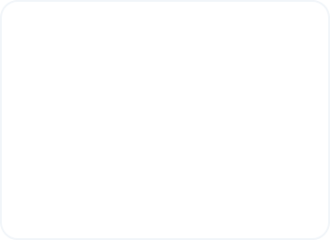
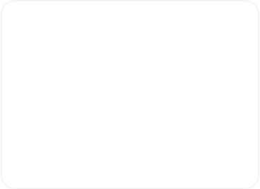
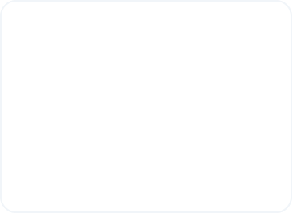



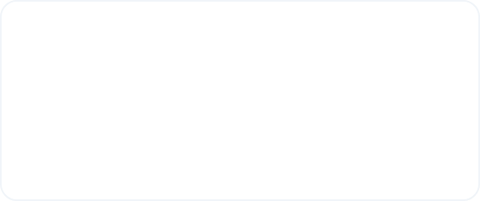
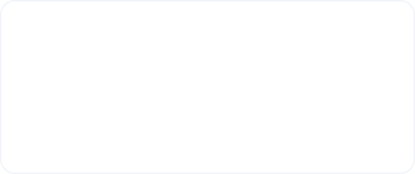


Workplace Vocabulary Match
Deadline
Stakeholder
Follow-up
The final date or time to finish a task.
Anyone involved in a project or decision.
An additional action after a meeting.
Workload
Priorities
The amount of work a person has to do.
The most important tasks to focus on.

Slide 4
Activity 1: Answer Key
Vocabulary Item | Definition Match
1. Deadline | (c) the final date to finish something
2. Stakeholder | (a) someone involved in a project or decision
3. Follow-up | (d) an additional message after a meeting
4. Workload | (b) the amount of work a person has
5. Priorities | (e) the most important tasks

Slide 5
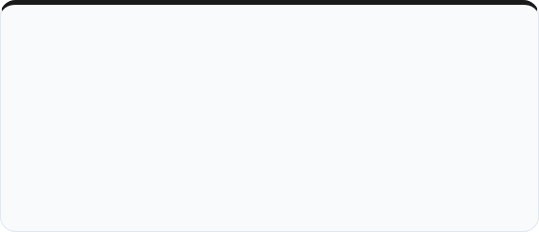
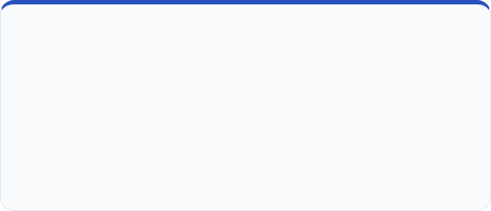


Direct vs. Diplomatic Language
The "Miranda" Style (Direct)
The "Professional" Style (Diplomatic)
"Finish this now."
"Could you finish this as soon as possible?"
Clear but can be perceived as aggressive. Best for urgent, high-stakes crises.
Maintains authority while respecting the colleague. Best for long-term teamwork.

Slide 6
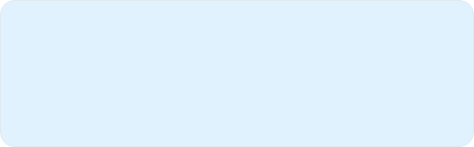
Rewrite the Message
Make these professional and polite:
1. I need the report today.
2. This is wrong. Fix it.
3. Call me later.
4. You missed the deadline.
Pro Tip: Use modal verbs like Could or Would and phrases like I noticed... to soften the tone.

Slide 7

ROLE PLAY SESSION
The Runway Magazine Crisis

Slide 8
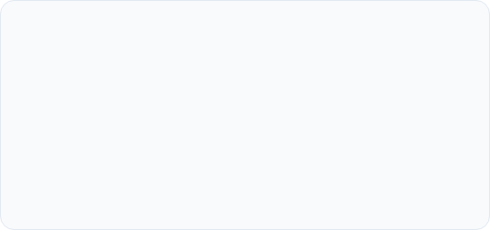
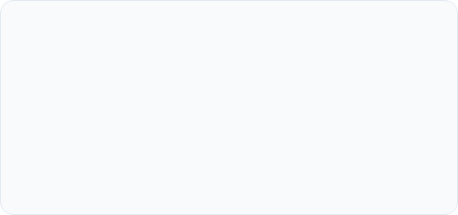

Manager vs. Assistant
Student A: The Manager
Student B: The Assistant
You need the presentation today. You want solutions, not excuses.
Explain the problem and negotiate a new timeline or solution.
•
"What's the status?"
•
"Could we adjust the timeline?"
•
"We need to move faster."
•
"The main issue is..."

Slide 9
Discussion Questions
What makes someone a good leader?
Is pressure necessary in the workplace?
How do you give professional feedback?
Direct vs. Diplomatic communication?

Slide 10
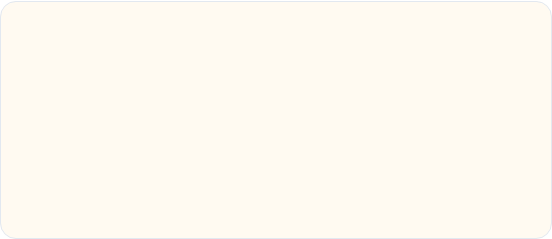
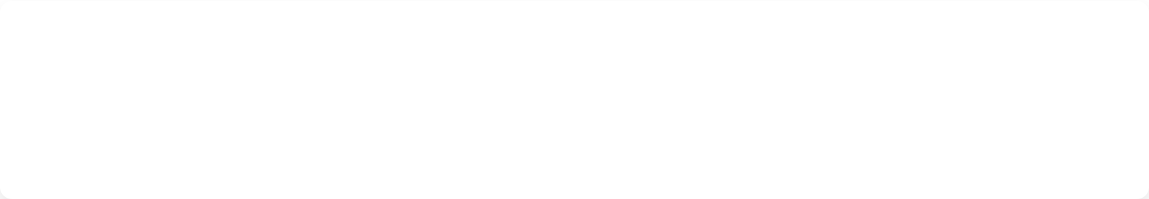
The Follow-up Email
Task: Imagine you just finished a meeting about a new campaign. Write a follow-up email including:
Subject: Campaign Update
•
The main decision
Hello team,
Thank you for today's meeting. We agreed to finalize the presentation by Friday...
•
Next steps
•
A clear deadline

Slide 11


Extra Challenges
Fast Finishers
Homework
Continue your role play for 1 minute focusing on negotiation language.
Write a Slack/Teams message summarizing a meeting using at least 3 vocabulary words from today.

Slide 12

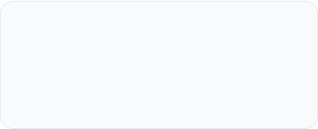
ANY QUESTIONS?
"That's all."
Teacher: [your name here]
Topic: Workplace English

Slide 13






Image Sources
https://cdn.mos.cms.futurecdn.net/v2/t:0,l:240,cw:1440,ch:1080,q:80,w:1440/HYTQ5mhnfRn36JXk35Nqnd.png
Source: www.whowhatwear.com
https://media.istockphoto.com/id/2004891060/photo/busy-mature-professional-business-woman-looking-at-laptop-working-in-office.jpg?s=612x612&w=0&k=20&c=lMpp8UwNY90zcr20ffQyZmk7yeEraYLwZmLyQRmZeuI=
Source: www.istockphoto.com
https://thumbs.wbm.im/pw/medium/2785497d53a5791ad5091c49faeb9bcf.jpg
Source: pikwizard.com
https://cdn.shopify.com/s/files/1/2726/4990/files/modern-ceo-aesthetic-outfits.jpg?v=1752253507
Source: vonbaer.com
https://img.freepik.com/premium-photo/multiracial-business-team-meeting-modern-bright-office-diverse-colleagues-working-project-together-sitting-table-boardroom_35675-2130.jpg
Source: www.freepik.com
https://cdn.shopify.com/s/files/1/0574/5491/9846/files/lgm-wall-bed-home-office-toronto-condo.jpg?v=1731515608
Source: resourcefurniture.com

